Slide 1
Understanding Computer Architecture
Study of how computer hardware is designed and how it executes programs
Explains interaction between CPU, memory, and input/output devices
Important for system design, performance optimization, and efficient software development

Slide 2
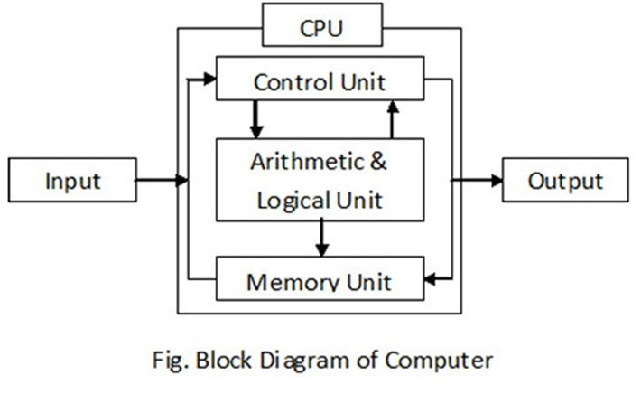
Introduction to Computer Architecture
Computer architecture refers to the logical design and operational structure of a computer system
It defines how hardware components communicate with each other
Focuses on instruction execution, memory organization, and data processing
Determines system efficiency and computational capability

Slide 3
Overview of Computer Architecture
Computer architecture includes CPU design, memory hierarchy, and I/O systems
It determines how instructions are fetched, decoded, and executed
It includes both hardware organization and performance optimization techniques
Modern architectures focus on parallel processing and energy efficiency

Slide 4
Importance in Software Development
Helps programmers understand how code runs on hardware
Enables writing optimized programs that use CPU and memory efficiently
Important in operating systems, compilers, and embedded systems
Knowledge of architecture helps reduce latency and improve execution speed

Slide 5
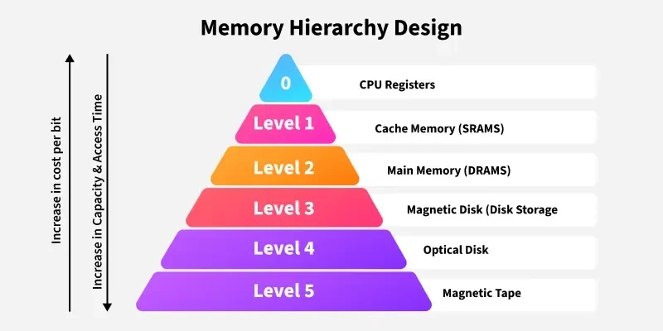
Basic Terminology
CPU – Central Processing Unit responsible for executing instructions ALU – Arithmetic Logic Unit that performs arithmetic and logical operations Registers – Small high‑speed storage locations inside the CPU Cache Memory – Fast memory used to store frequently accessed data Main Memory (RAM) – Primary memory used to store active programs and data Instruction Set – Set of commands a processor can understand and execute

Slide 6
Historical Development of Computer Architectures
First Generation (1940s–1950s): Vacuum tubes used for processing
Second Generation (1950s–1960s): Transistors replaced vacuum tubes
Third Generation (1960s–1970s): Integrated circuits increased reliability
Fourth Generation (1970s–present): Microprocessors and personal computers
Modern systems: Multi‑core processors, GPUs, and cloud computing

Slide 7
RISC vs CISC Architectures
RISC (Reduced Instruction Set Computer):
Uses simple instructions
Executes instructions in fewer clock cycles
Easier pipeline implementation
Example: ARM processors
CISC (Complex Instruction Set Computer):
Large number of complex instructions
Instructions can perform multiple operations
Reduces number of instructions per program
Example: x86 processors

Slide 8
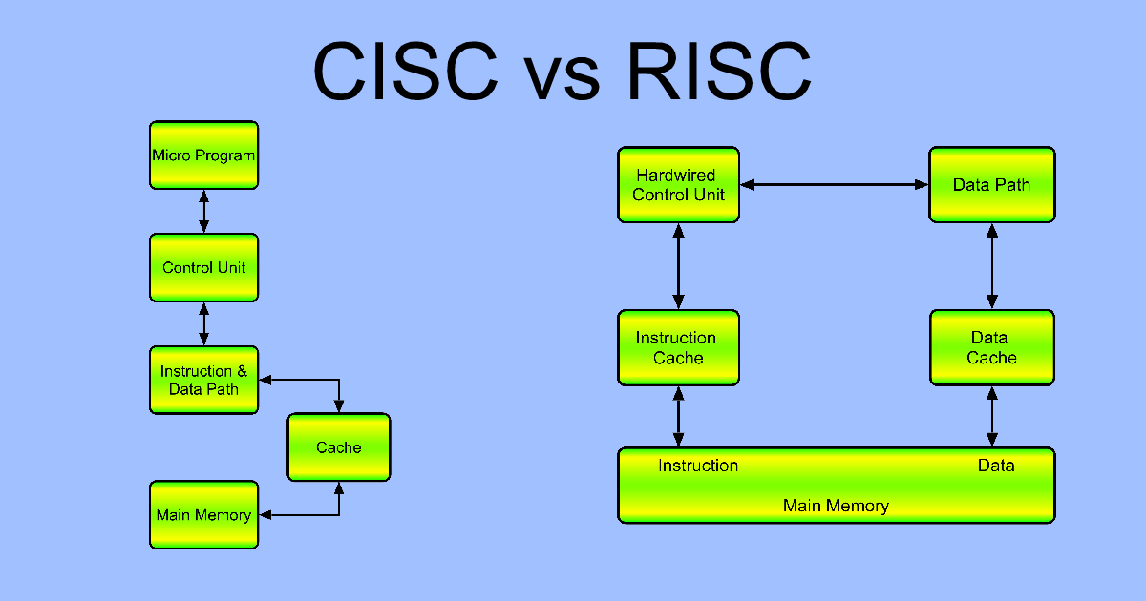

Slide 9
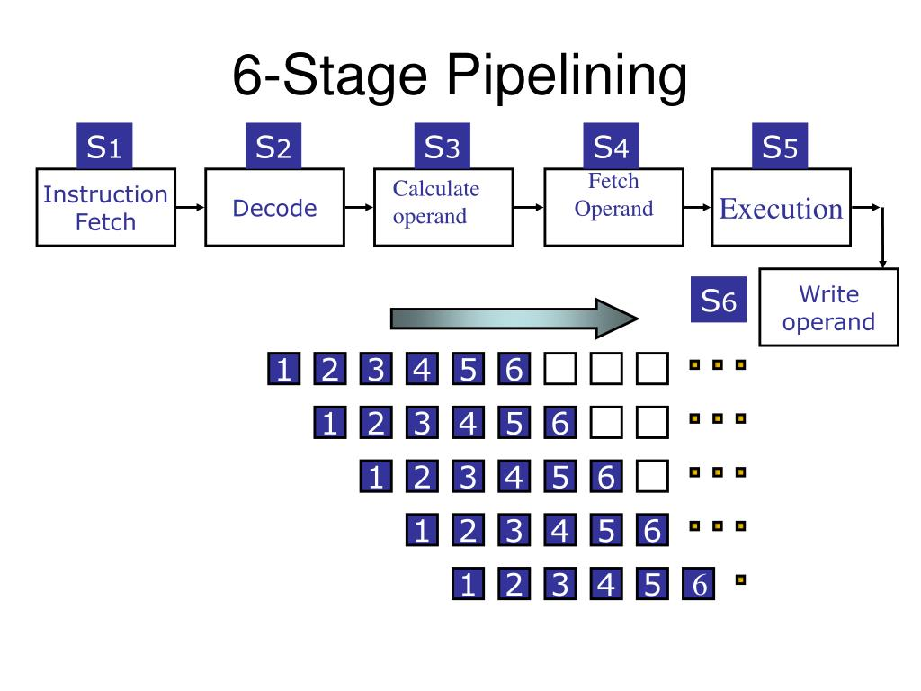
Pipeline Processing
Technique used to improve CPU performance
Allows multiple instruction stages to execute simultaneously
Similar to an assembly line in manufacturing
Pipeline stages:
Instruction Fetch
Instruction Decode
Execute
Memory Access
Write Back

Slide 10
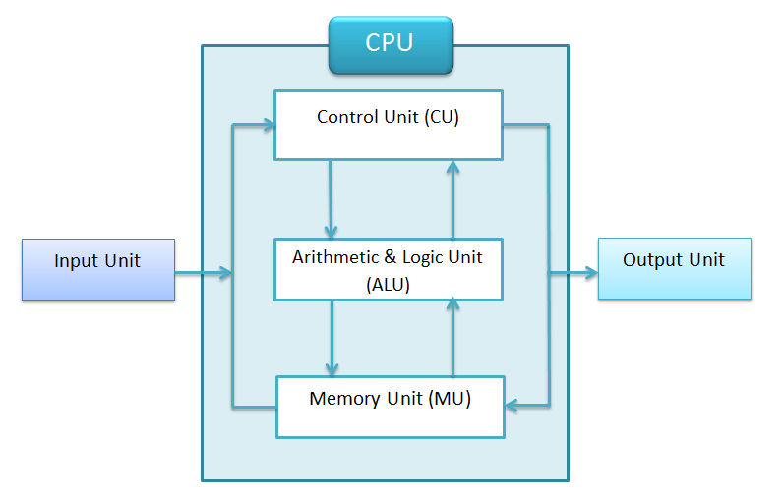
Computer Arithmetic and ALU Design
ALU performs arithmetic operations such as addition, subtraction, multiplication
Also performs logical operations like AND, OR, XOR, and comparisons
Works closely with registers and control unit
Essential for mathematical calculations and decision making

Slide 11
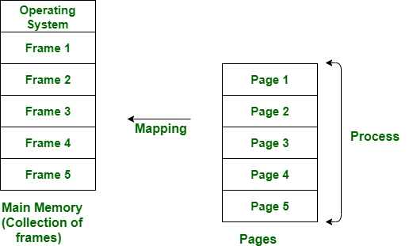
Virtual Memory and Paging Systems
Virtual memory allows a system to run large programs even with limited RAM
Uses disk storage as an extension of main memory
Paging divides memory into fixed size blocks called pages
Improves memory management and supports multitasking

Slide 12
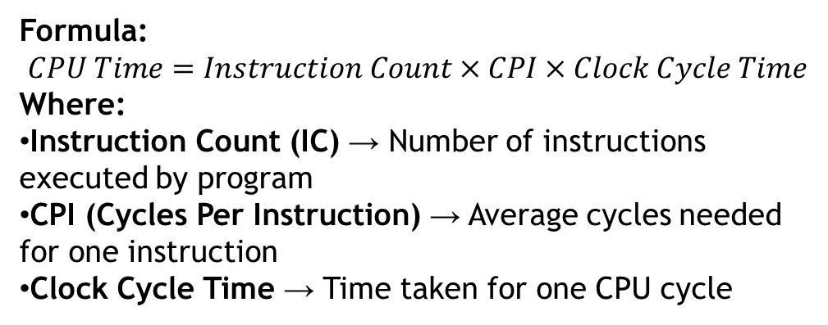
Benchmarking and Performance Metrics
Benchmarking measures system performance using standard tests
Metrics include:
Execution Time
CPU Clock Cycles
Instructions Per Second (IPS)
Throughput
Used to compare processors and optimize system performance
Formula:
$$CPU Time=Instruction Count×CPI×Clock Cycle Time$$
Where:
Instruction Count (IC) → Number of instructions executed by program
CPI (Cycles Per Instruction) → Average cycles needed for one instruction
Clock Cycle Time → Time taken for one CPU cycle

Slide 13
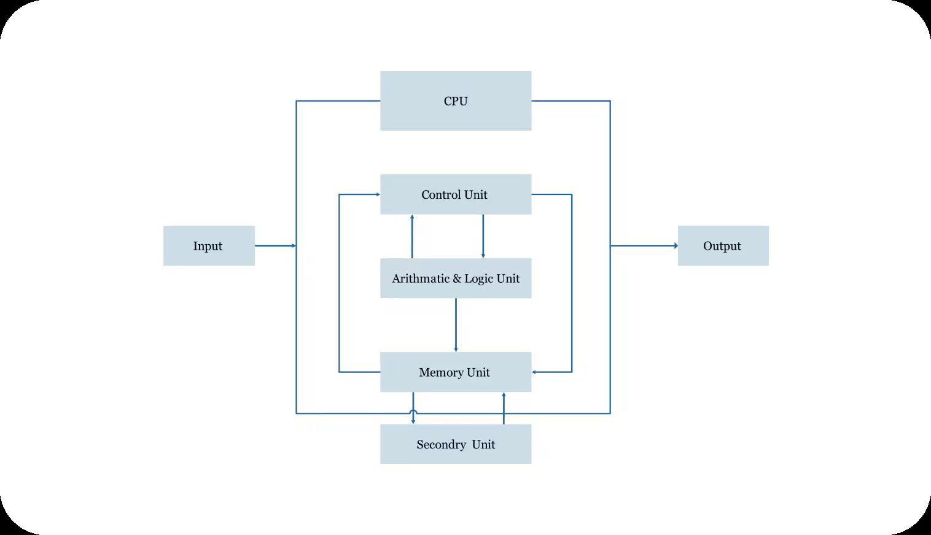
Central Processing Unit (CPU)
CPU is the brain of the computer
Responsible for executing instructions and controlling system operations
Performs arithmetic, logic, and data movement operations
Works with memory and input/output devices

Slide 14
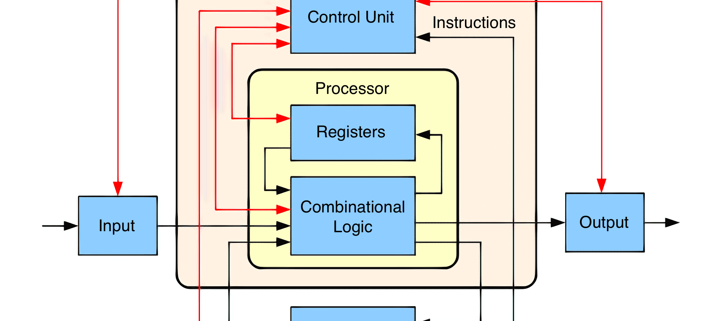
CPU Components and Functions
ALU – Performs arithmetic and logical calculations Control Unit – Directs the operation of the processor Registers – Temporary storage for instructions and data Cache – Stores frequently used data for faster access
Functions:
Instruction processing
Data manipulation
System control

Slide 15
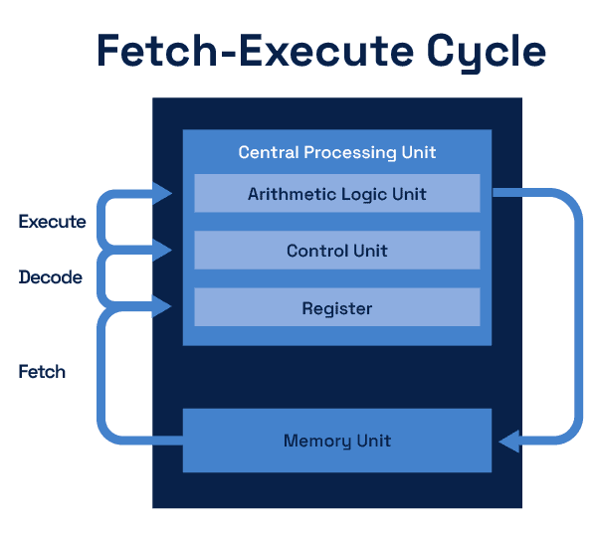
How a CPU Executes Instructions
Instruction cycle consists of four main stages:
Fetch – CPU retrieves instruction from memory
Decode – Control unit interprets the instruction
Execute – ALU performs the required operation
Store – Result is written back to memory or register

Slide 16
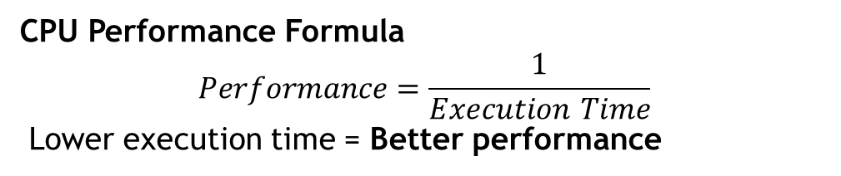
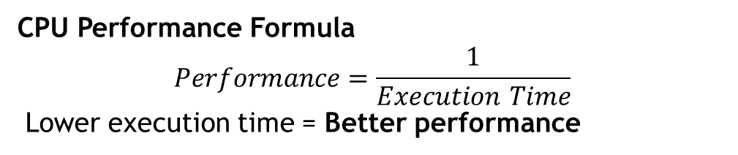
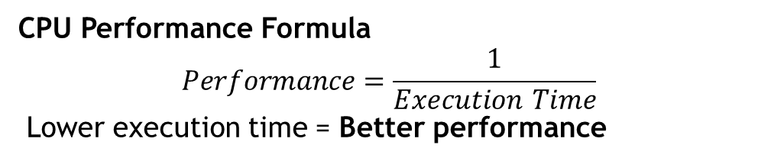
CPU Performance Factors
Factors affecting CPU performance:
Clock speed (GHz)
Number of cores
Cache size
Instruction level parallelism
Memory bandwidth
Thermal management
CPU Performance Formula
$$Performance=\frac{1}{Execution Time}$$
Lower execution time = Better performance
CPU Performance Formula
$$Performance=\frac{1}{Execution Time}$$
Lower execution time = Better performance
CPU Performance Formula
$$Performance=\frac{1}{Execution Time}$$
Lower execution time = Better performance

